Slide 1


ADVENTURE WORKS

Slide 2

INTRODUCTION
OBJECTIVE
AGENDA
PROBLEM STATEMENT
CONCLUSION

Slide 3

INTRODUCTION
Adventure Works is rapidly growing multinational company with a core business of bicycle manufacturing.
The Company manufactures & sells metal and composite bicycles to North American, European and Asian commercial markets.
Adventure Works involves analyzing and visualizing sales and customer data.

Slide 4
Objective
Adventure Works offers a complex yet understandable database schema that mimics a real-world business.
It includes various business domains such as sales, manufacturing, and human resources, allowing users to explore relationships across diverse business functions.

Slide 5
Problem Statement
Year wise Sales
Yearly Income Distribution
Sales amount V/S Production Cost
Top product categories with
best dealer price
Country wise Profit

Slide 6
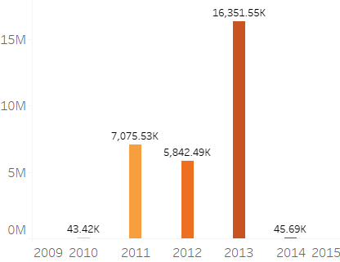
Year wise Sales status
The bar chart effectively visualizes the differences in sales across the year, with taller bars indicating higher sales and shorter bars reflecting lower sales periods.
This visual representation helps identify seasonal trends and performance peaks, aiding in strategic planning and analysis.

Slide 7
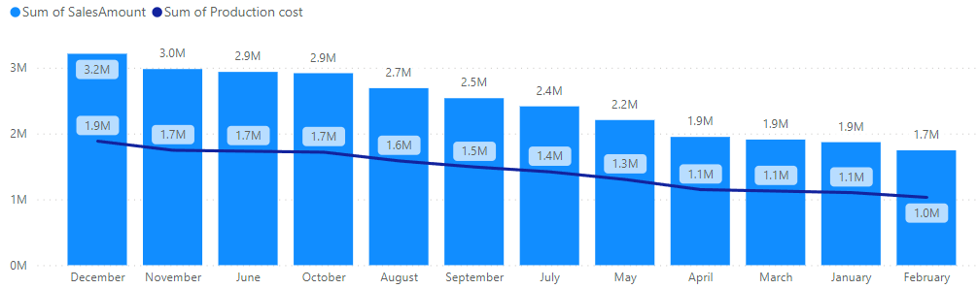
Monthly Sales V/S Production Cost
The Bar chart segment display sum of sales amount while the overlaid Line chart tracks Production cost over the same period, providing a dual perspective on financial performance and marketing expansion.

Slide 8
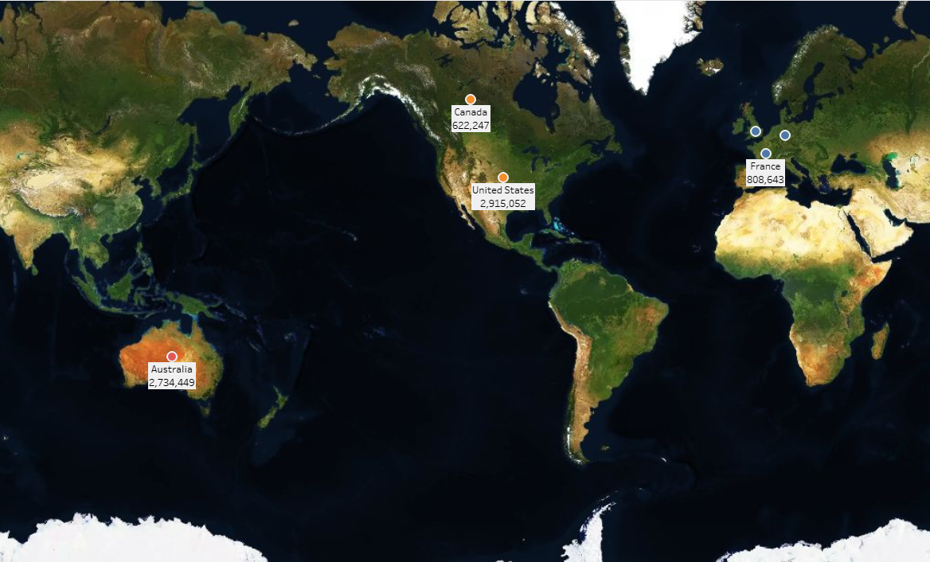
Country wise Profit status
This KPI represented country wise profits across the globe and the highest profits across the globe are in the United States followed by Australia and others.

Slide 9
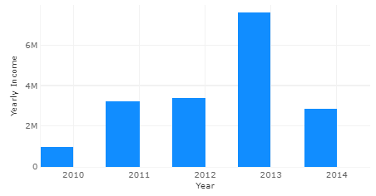
Yearly Income Distribution
A series of histograms comparing yearly income distribution across different years can illustrate changes in economic conditions and shifts in wealth over time. Each histogram represents a specific year, with income ranges on the horizontal axis and the frequency of earners in those ranges on the vertical axis.

Slide 10
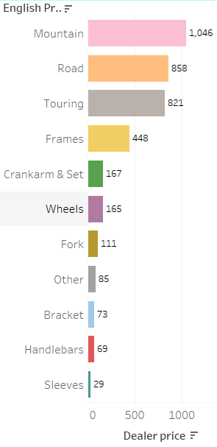
Top Product categories with best dealer price
This KPI clubbed different products into different categories accordingly and the results shows a high demand for mountain bicycles and road bicycles followed by other categories when compared with dealer price.

Slide 11
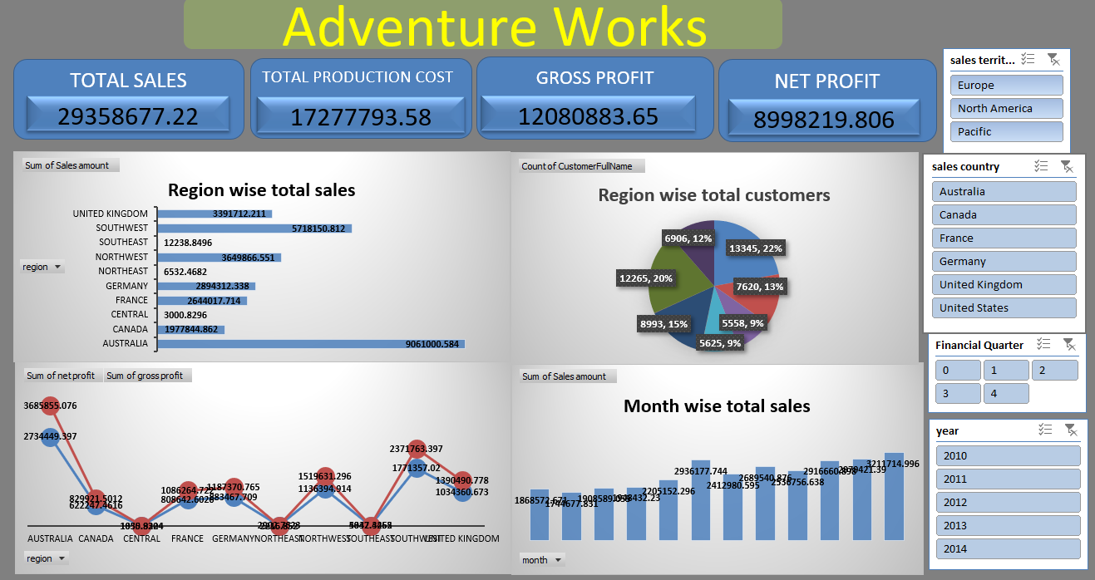
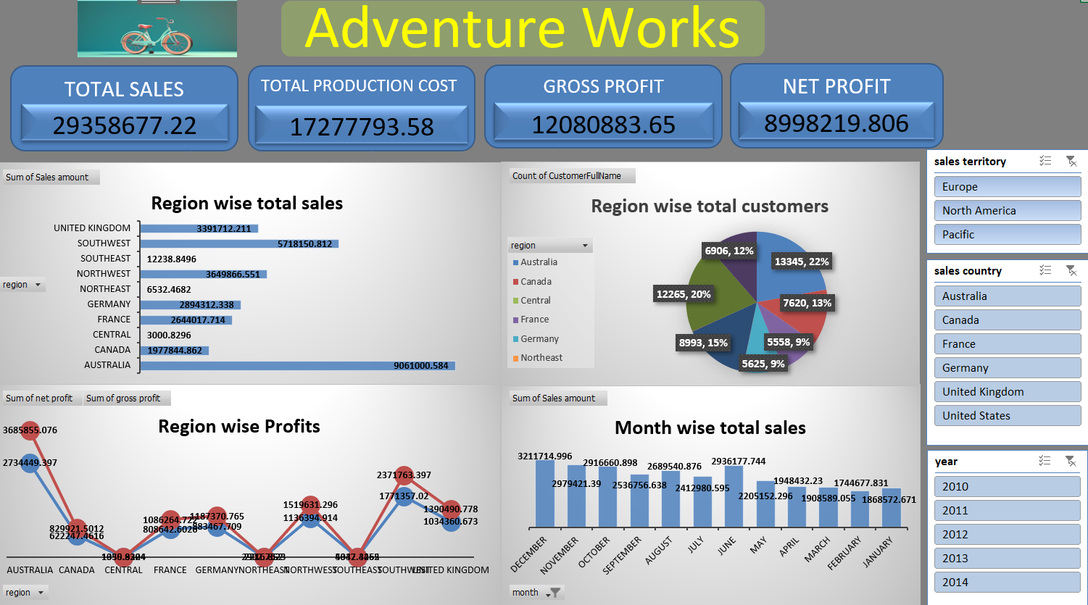
Excel Dashboard

Slide 12
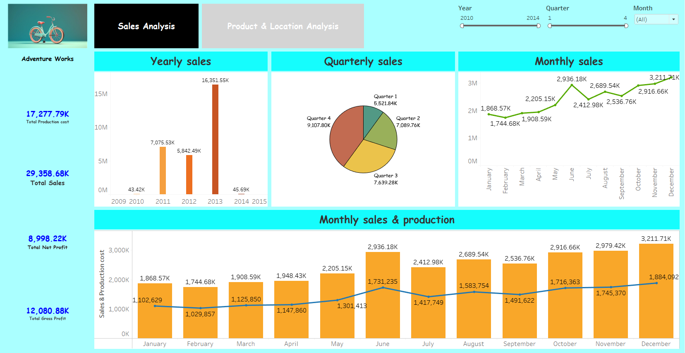
Tableau Dashboard

Slide 13
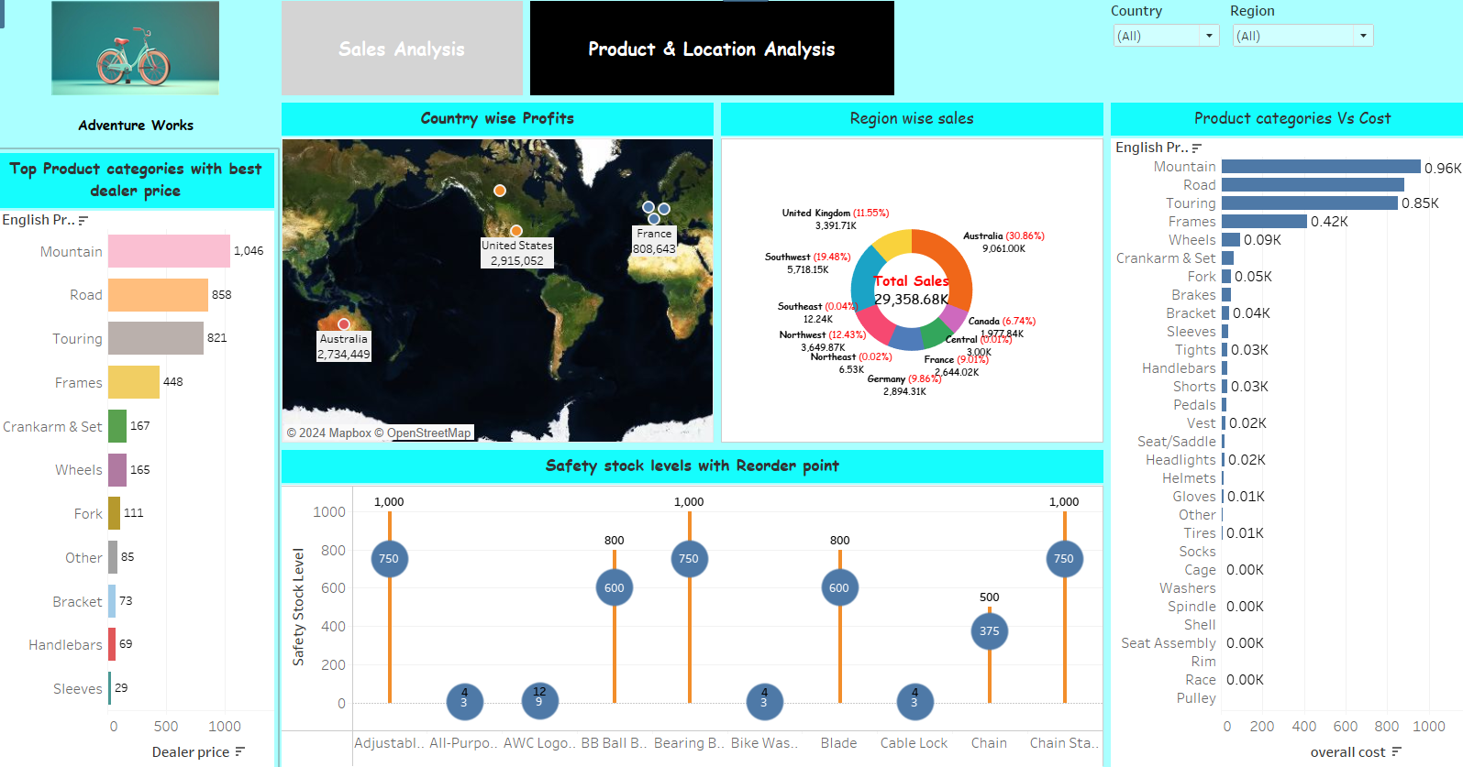

Slide 14
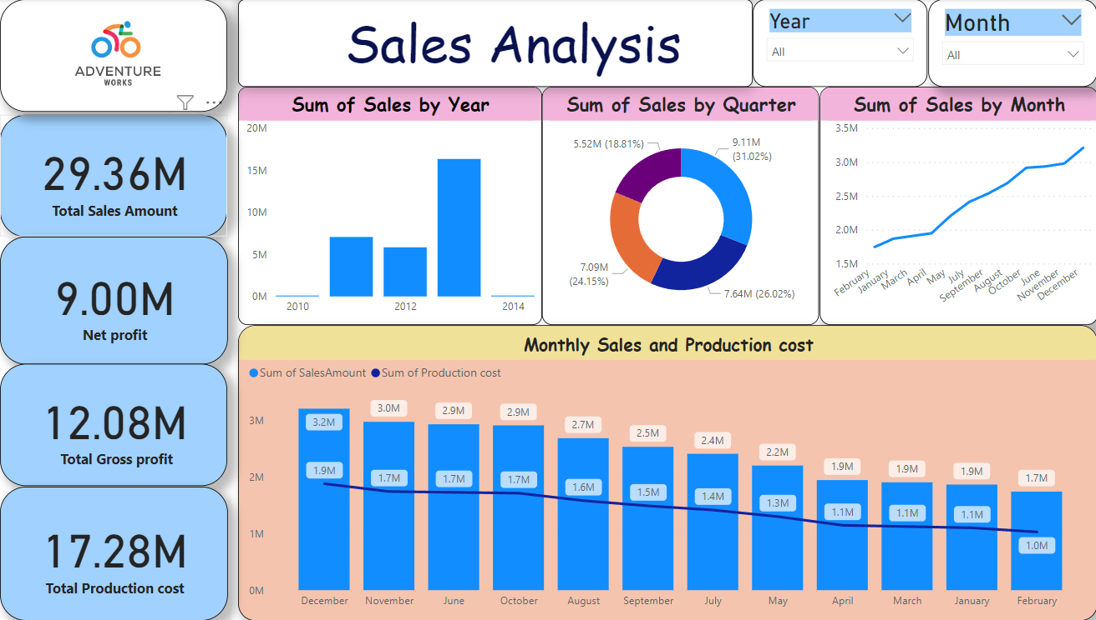
Power BI Dashboard

Slide 15
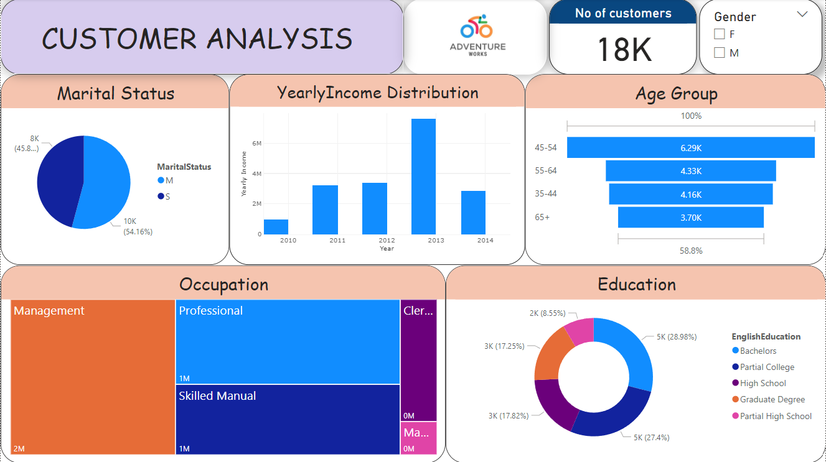

Slide 16
CONCLUSION
The Adventure Works database allows users to experience and manipulate data as it would appear in a real business environment, making the learning experience much more applicable to real-world scenarios.
The database is used widely across different platforms and technologies, demonstrating its adaptability and relevance in various IT environments and applications.
Adventure Works has not only provided a benchmark for comparing database tools and performance but has also fostered a community of learners, educators, and professionals. This collective group continues to evolve, contributing to improvements and innovations in database technologies and methodologies.
The Adventure Works project underscores the importance of practical, hands-on experience in learning and professional development. Moving forward, it could be expanded to include more diverse scenarios, integrate with new technological advancements like cloud computing and AI, and continue serving as a cornerstone for educational endeavors in database management and business intelligence.

Slide 17
THANK YOU

